Slide 1
Lecture 09: Clustering
Chris Walshaw
Computing & Mathematical Sciences
University of Greenwich

Slide 2
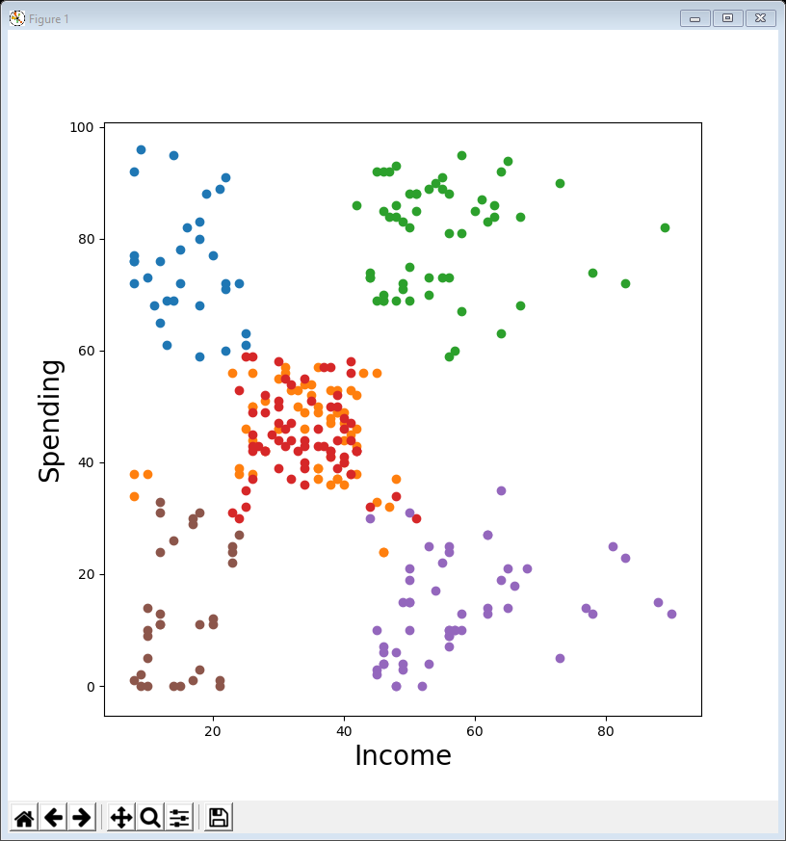
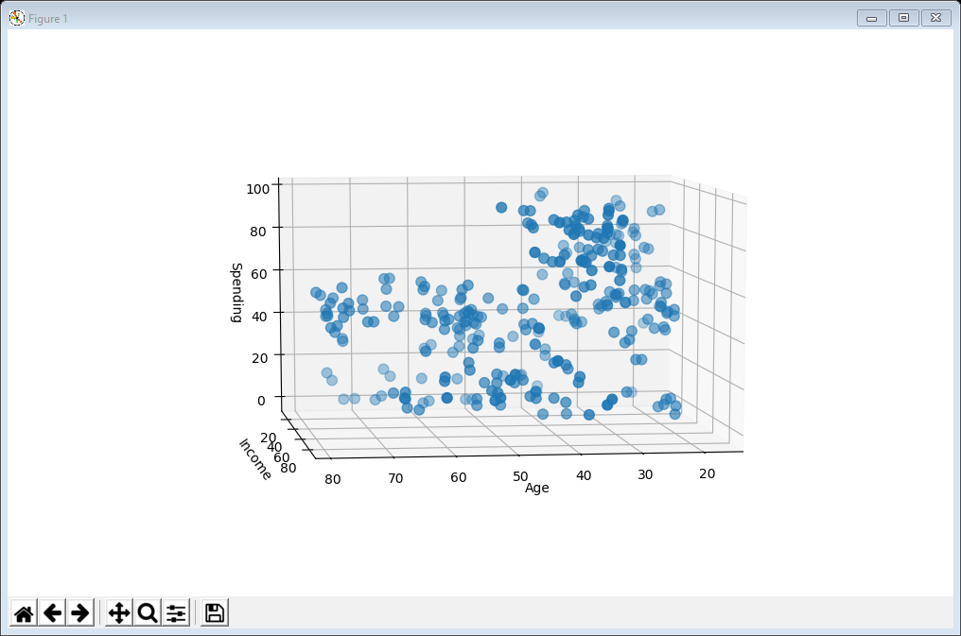
Motivation / Objectives
For the last two weeks we have looked at interaction & dashboards
allows the user to examine and monitor the data on their own
For the final two lectures we will look at clustering and dimension reduction
crucial visualisation techniques for large-scale data-intensive applications
We will use a number of visualisation techniques we have already encountered
scatter plots, line plots, box plots, histograms & radar plots
Plus one new one
3d scatter plot

Slide 3
What is clustering?
Many data-intensive applications have too much data to handle by manual segmentation
e.g. too many variables or too many data-points or both
Clustering is used to group similar items together
e.g. could group similar product types
It is usually done (semi-)automatically using tools that look at the abstract data without knowing anything about it
it is a form of unsupervised machine learning
There are many clustering algorithms – some popular variants include hierarchical, DBSCAN & k-means
all of these (and many more) are included in the scikit-learn library
see https://scikit-learn.org/stable/modules/clustering.html
from sklearn.cluster import KMeans
from sklearn.metrics import silhouette_score

Slide 4
k-means clustering
One of the most intuitive clustering algorithms is called k-means
here k refers to the number of clusters – you have to choose how many you want
The algorithm goes as follows
randomly locate k centroids (cluster centres)
attach each data-point to its nearest centroid
move the centroids to the centre (the mean value) of all their attached data-points
go back to 2 and repeat until the centroids stop moving
Demo: https://youtu.be/5I3Ei69I40s

Slide 5
01ScatterPlot clustering marketing sales.py
Let’s start by clustering some familiar data – the marketing & sales variables from the summary data-frame we have used many times
The line in bold actually does the clustering
it returns a list of labels (0, 1, 2 or 3) denoting which cluster each product has been assigned to
The loop then creates 4 data-frames, one for each cluster, containing summary data rows for that cluster
k = 4
selected = ['Marketing', 'Sales']
k_means = KMeans(n_clusters=k, init='k-means++', random_state=1)
summary_data['label'] = k_means.fit_predict(summary_data[selected])
clusters = []
for c in range(k):
clusters.append(summary_data[summary_data['label'] == c])

Slide 6
01ScatterPlot clustering (cont’d)
Now we just need to visualise the clusters
The first loop iterates over the clusters, drawing a scatter plot of the products in that cluster
so each cluster gets a different colour
The second loop annotates the product names
so we know which product is in which cluster
plt.figure(figsize=(8, 8))
for c in range(k):
plt.scatter(clusters[c]['Marketing'], clusters[c]['Sales'], s=100)
for i, name in enumerate(summary_data.index):
plt.annotate(name, (summary_data['Marketing'][i],
summary_data['Sales'][i]))
plt.xlabel('Marketing')
plt.ylabel('Sales')
plt.show()

Slide 7
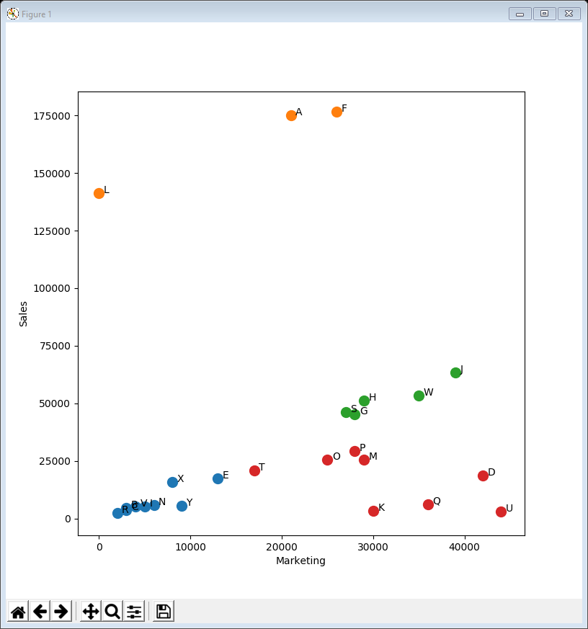
Interpretation
The 4 clusters that have been chosen by the algorithm (without it knowing anything about the data) are:
orange: all the high volume products
green: all the medium volume products
red: low & very low volume products with high marketing spend
blue: low & very low volume products with low marketing spend

Slide 8
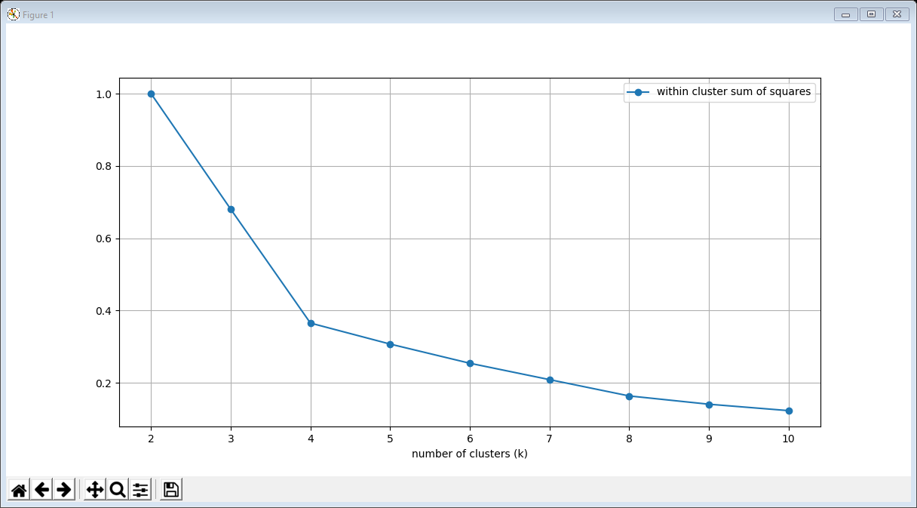
How many clusters?
We might have chosen 4 because we know something about the data
but typically that’s not the case and often we can’t even visualise the data (too many dimensions)
There are a number of techniques for choosing k, the number of clusters, automatically
Usually the idea is to try several different values for k and evaluate which is best
Elbow method: plot the “within-cluster sums of squares” (WCSS) for each k and look for an “elbow” point https://en.wikipedia.org/wiki/Elbow_method_(clustering)
Silhouette method: calculate the “average silhouette score” for each k and find the maximum https://en.wikipedia.org/wiki/Silhouette_(clustering)
the elbow (where the line bends)

Slide 9
02LinePlot clusterings marketing sales.py
Scikit-learn can calculate both WCSS & silhouette scores
Choose the min & max values for k
Compute a clustering for each value of k
add the WCSS & silhouette scores to lists
Normalise the WCSS values to lie between 0 and 1 (already true for silhouette scores)
selected = ['Marketing', 'Sales']
min_k = 2
max_k = 10
k_values = range(min_k, max_k + 1)
WCSS = []
silhouette = []
for k in k_values:
k_means = KMeans(n_clusters=k, init='k-means++', random_state=1)
labels = k_means.fit_predict(summary_data[selected])
WCSS.append(k_means.inertia_)
silhouette.append(silhouette_score(summary_data[selected], labels))
WCSS = np.asarray(WCSS) / max(WCSS)

Slide 10
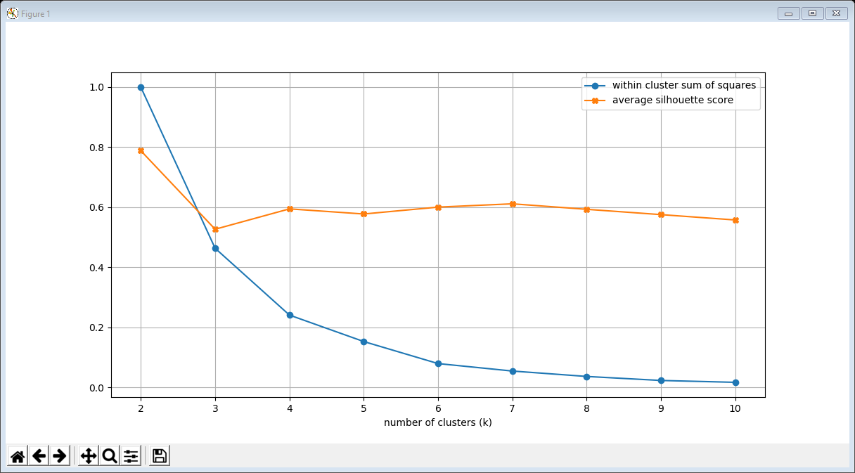
02LinePlot clusterings (cont’d)
Now visualise the WCSS & silhouette scores
plt.figure(figsize=(12, 6))
plt.plot(k_values, WCSS, marker='o',
label='within cluster sum of squares')
plt.plot(k_values, silhouette, marker='X',
label='average silhouette score')
plt.xlabel('number of clusters (k)')
plt.legend()
plt.grid()
plt.show()
no pronounced elbow for WCSS
silhouette has maxima at 2
and locally at 7

Slide 11
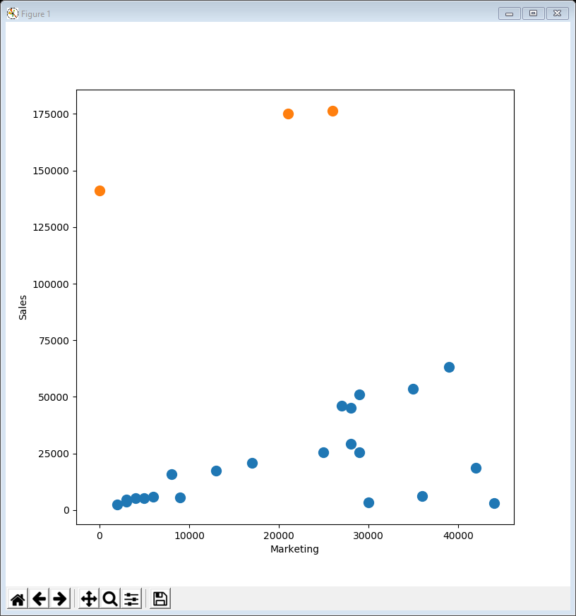
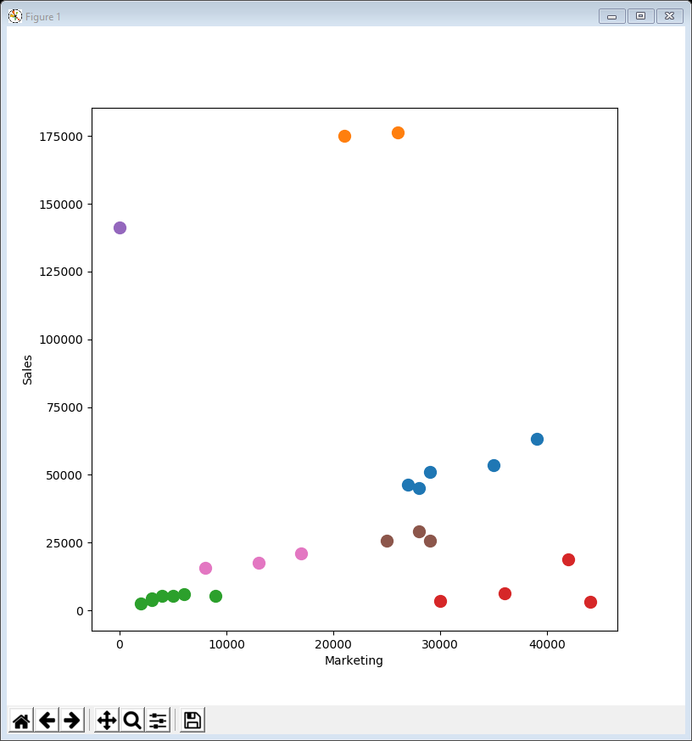
01ScatterPlot clustering (repeated)
Just run example 01 again but with k = 2 and k = 7

Slide 12
Interpretation
Because we are clustering in 2 dimensions (Marketing and Sales) we can easily identify the clusters visually
the data-points which are closest together
For k = 2 the clustering has separated out the high volume sales as they are far enough away from everything else to be considered as a group
For k = 7 it has separated out the 4 different sales volumes (high, medium, low & very low)
And additionally the high, low & very low volumes have been split into 2 groups each
low marketing (left-hand side – purple, pink & green)
high marketing (right-hand side – orange, blue, brown & red)

Slide 13
Customer Segmentation
A popular use for clustering is customer segmentation to understand different types of customer
e.g. for marketing purposes
We will now carry out an exploration and clustering of 300 ChrisCo customer profiles
the dataset is loosely based on one from Kaggle.com, an organisation that runs data science competitions (with cash prizes!)
https://www.kaggle.com/vjchoudhary7/customer-segmentation-tutorial-in-python
Each customer profile contains basic info such as gender, age, annual income (in £1,000s), monthly spending at ChrisCo (in £s)

Slide 14
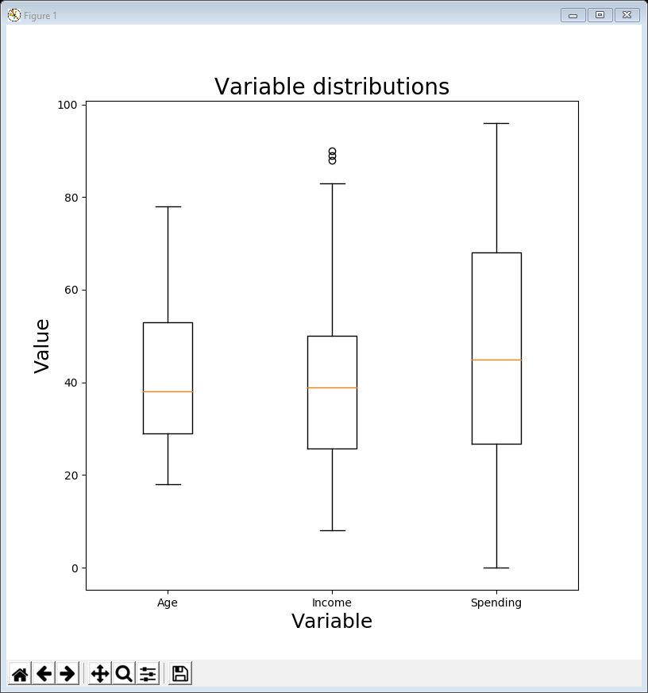
03BoxPlot spending income.py
First let’s get a sense of the numerical data with a box plot
The line in bold creates the plot (see Lecture 5)
Output from .describe()
Age: 18 to 78, with an average of 42
Annual income: £8,000 to £90,000, with an average of £38,000
Monthly spending: £0 to £96, with an average of £45
profiles = pd.read_csv('https://tinyurl.com/ChrisCoDV/CustomerProfiles.csv')
print(profiles.head())
print(profiles.describe())
selected = ['Age', 'Income', 'Spending']
plt.figure(figsize=(8, 8))
plt.boxplot(profiles[selected], labels=selected)
plt.xlabel('Variable', fontsize=18)
plt.ylabel('Value', fontsize=18)
plt.title('Variable distributions', fontsize=20)
plt.show()

Slide 15
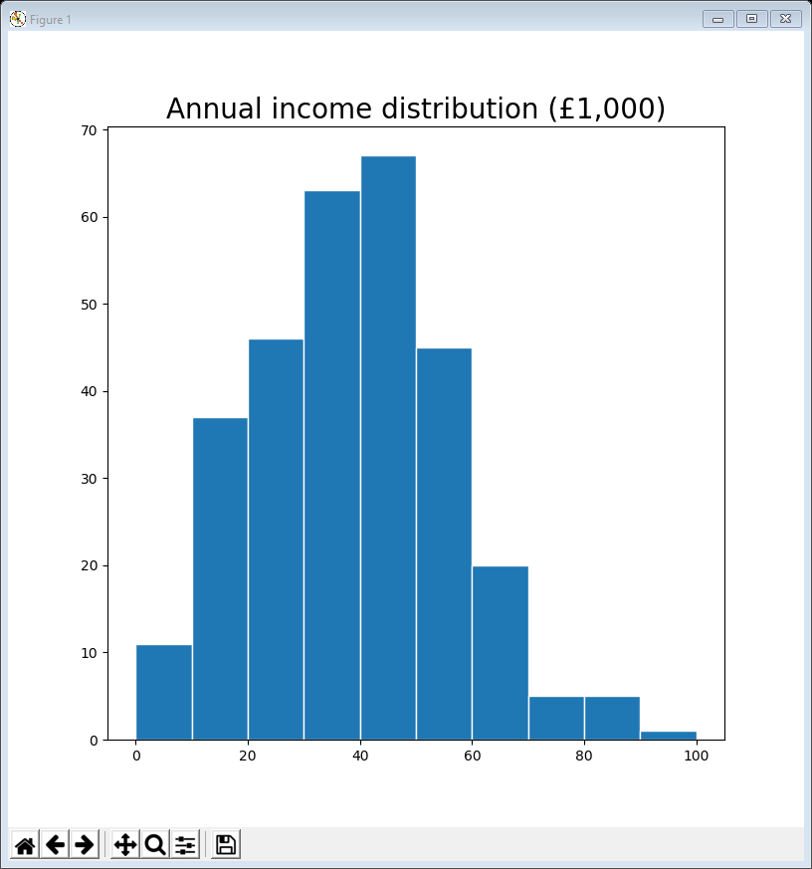
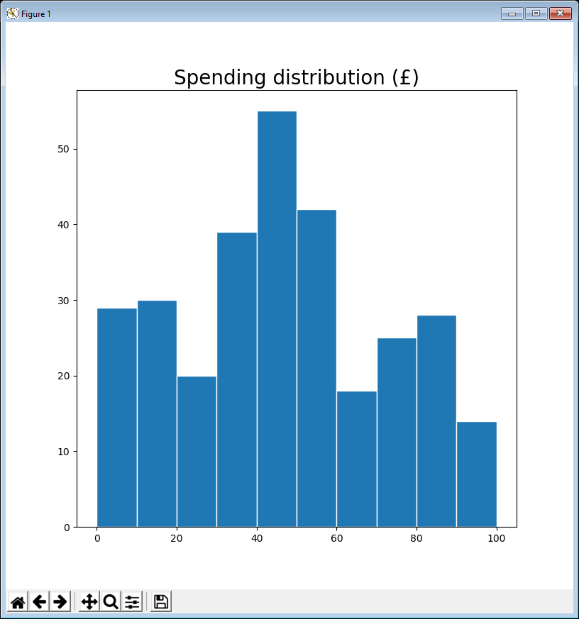
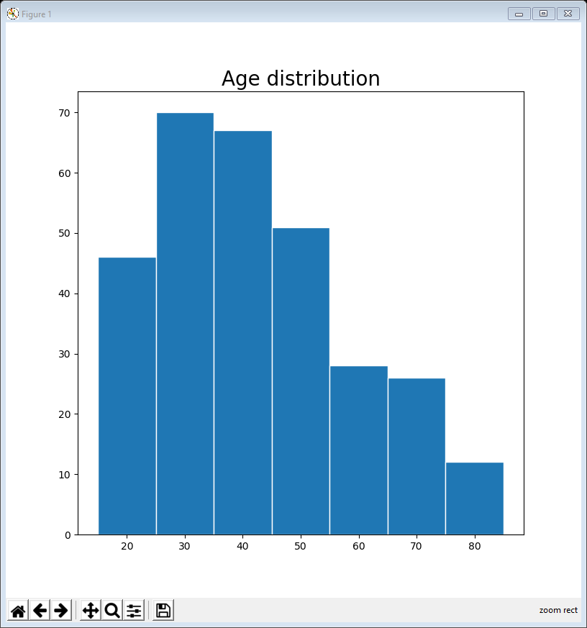
Examples 4, 5 & 6
Can also create histograms of each variable
The largest age group is 25-34, with 70 people
Code is almost identical for examples 5 & 6, spending & income
Monthly spending: most common bracket is £40-£49, with 55 people
Annual income: most common bracket is £40,000-£49,999, with 67 people
So we can get a sense of the population but not how to group them
x_min = 15
x_max = 85
bin_width = 10
n_bins = int((bin_width + x_max - x_min) / bin_width)
print(str(n_bins) + ' bins')
bins = [(x_min + x * (bin_width + x_max - x_min) / n_bins)
for x in range(int(n_bins))]
plt.figure(figsize=(8, 8))
plt.hist(profiles['Age'], bins=bins, edgecolor='w')
plt.title('Age distribution', fontsize=20)
plt.show()

Slide 16
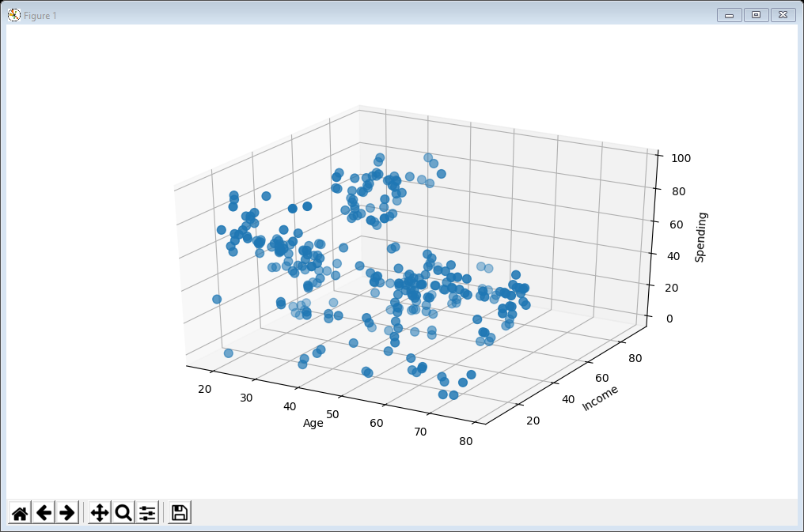
07ScatterPlot3d profiles.py
Since there are only 3 variables we can actually create a 3d scatter plot and try to “spot” clusters
from mpl_toolkits.mplot3d import Axes3D
fig = plt.figure(figsize=(10, 6))
sub = fig.add_subplot(111, projection='3d')
sub.scatter(profiles['Age'], profiles['Income'], profiles['Spending'], s=60)
sub.set_xlabel('Age')
sub.set_ylabel('Income')
sub.set_zlabel('Spending')
plt.show()
works better as a standalone (than in a notebook) as the plot is interactive and can be rotated

Slide 17
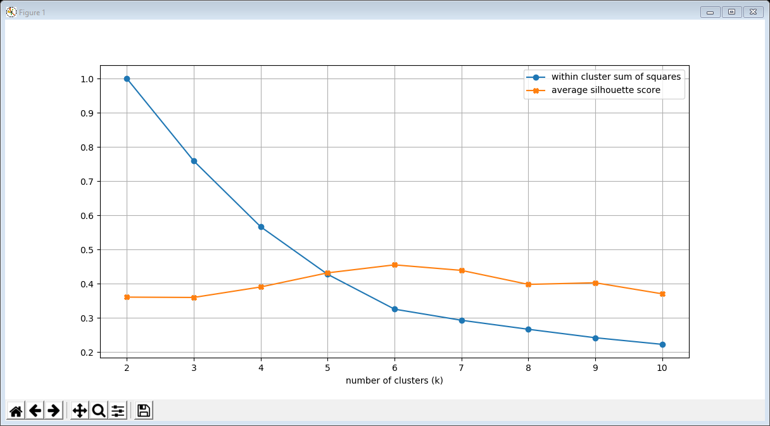
08LinePlot profiles clusterings.py
That doesn’t really work so let’s try to determine the optimal number of clusters
The clustering code is almost identical to example 2
The visualisation code is identical to example 2
Both the elbow and the max silhouette score occur at k = 6
selected = ['Age', 'Income', 'Spending']
min_k = 2
max_k = 10
k_values = range(min_k, max_k + 1)
WCSS = []
silhouette = []
for k in k_values:
k_means = KMeans(n_clusters=k, init='k-means++', random_state=1)
labels = k_means.fit_predict(profiles[selected])
WCSS.append(k_means.inertia_)
silhouette.append(silhouette_score(profiles[selected], labels))
WCSS = np.asarray(WCSS) / max(WCSS)

Slide 18
09ScatterPlot profiles clustering.py
We can now do a k-means clustering with k = 6
The clustering code is very similar to example 1
To visualise the clusters can do either
2d scatter plots with each pair of variables
a 3d scatter plot
k = 6
selected = ['Age', 'Income', 'Spending']
k_means = KMeans(n_clusters=k, init='k-means++', random_state=1)
profiles['label'] = k_means.fit_predict(profiles[selected])
clusters = []
for c in range(k):
clusters.append(profiles[profiles['label'] == c])

Slide 19
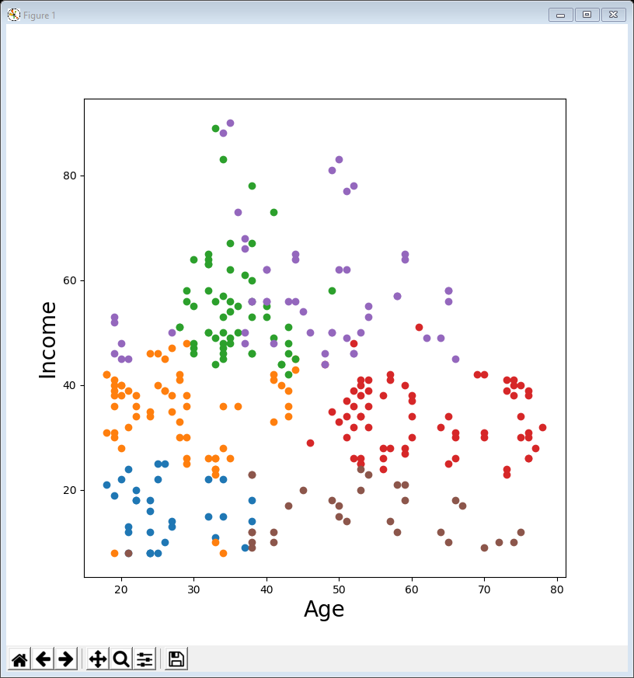
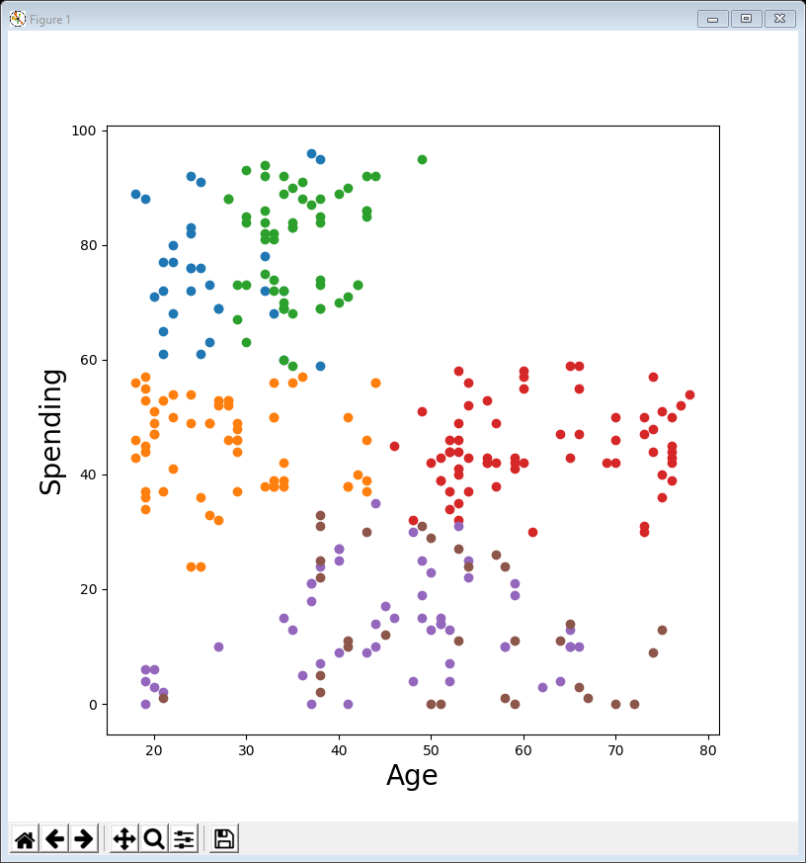
09ScatterPlot profiles (cont’d)
The problem with 2d scatter plots is that the clusters are usually 3 dimensional
however, it may be possible to spot them if the clustering is orthogonal (at right angles) to our viewpoint
here the red / orange clustering is determined by age but our viewpoint is along the income axis, so they are orthogonal
here the blue / green / brown purple clustering is determined by income & spending but our viewpoint is along the age axis, so they are orthogonal

Slide 20
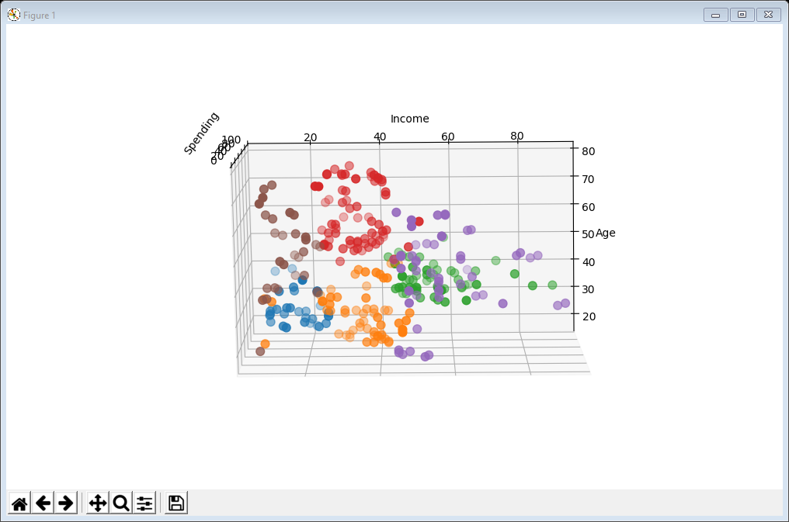
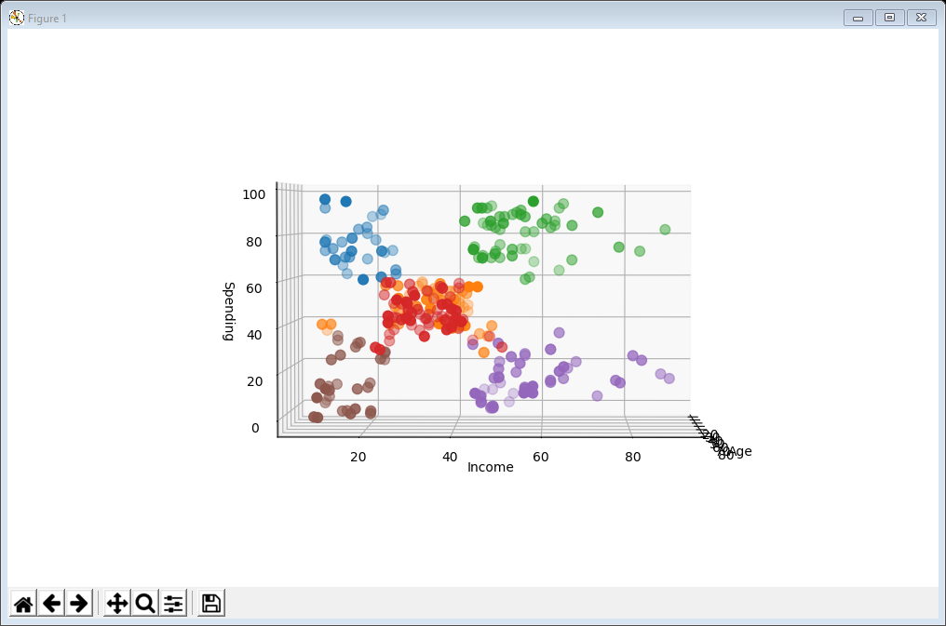
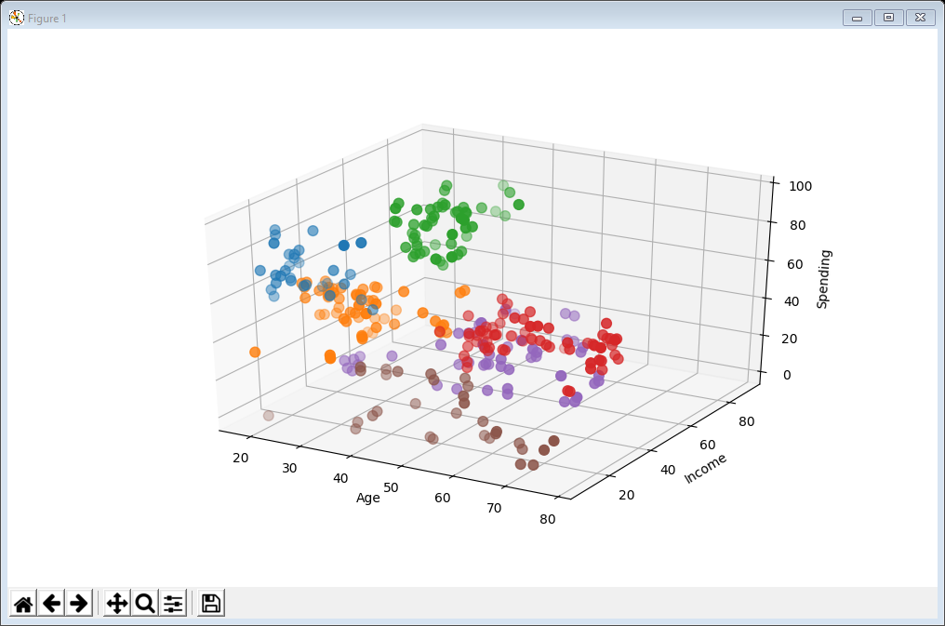
09ScatterPlot profiles (cont’d)
The 3d scatter plot is the most useful tool
especially the interactive version
middle income, older people
low income, high spenders
high income, high spenders
low income, low spenders
high income, low spenders
middle income, younger people

Slide 21
Interpretation
Six distinct groups
low income, high spenders
low income, low spenders
high income, low spenders
high income, high spenders
middle income, older people
middle income, younger people
But you can’t segment by a single pair of variables, e.g.
low income, high spenders … can be old or young
middle income, older people … can be high spenders or low spenders
And that’s just for 3 variables … what if there are 5, like the summary data … or even more

Slide 22
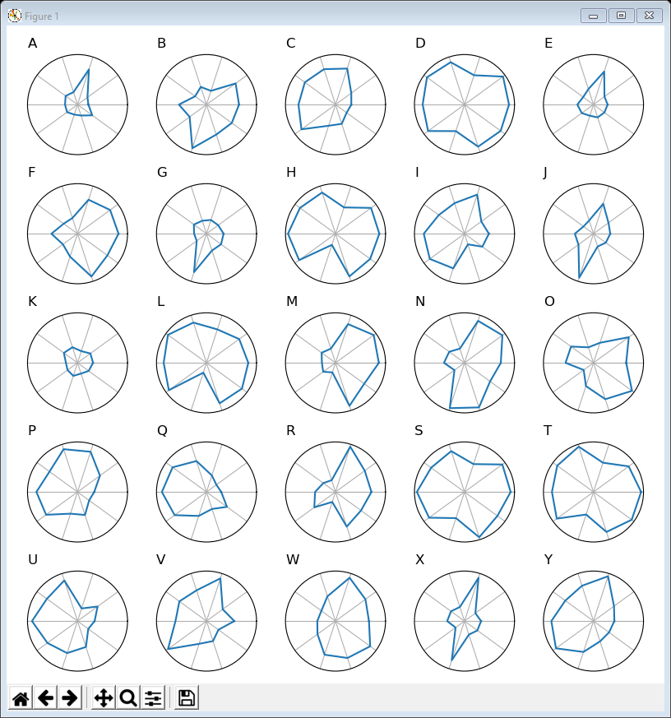
10RadarPlot ratings subplots.py
Let’s finish by looking at dataset where there are 10 variables, the ChrisCo product ratings
the company asks customers to rate each product purchased in 10 categories
We can use techniques from lecture 6 to visualise
the radar plot code is exactly the same as example 4
But it’s quite hard to spot any obvious segmentation by rating characteristics
and impossible if there were 250 products or 2,500
ratings = pd.read_csv('https://tinyurl.com/ChrisCoDV/Products/Ratings.csv',
index_col=0)
normalised_data = ratings / ratings.max()

Slide 23
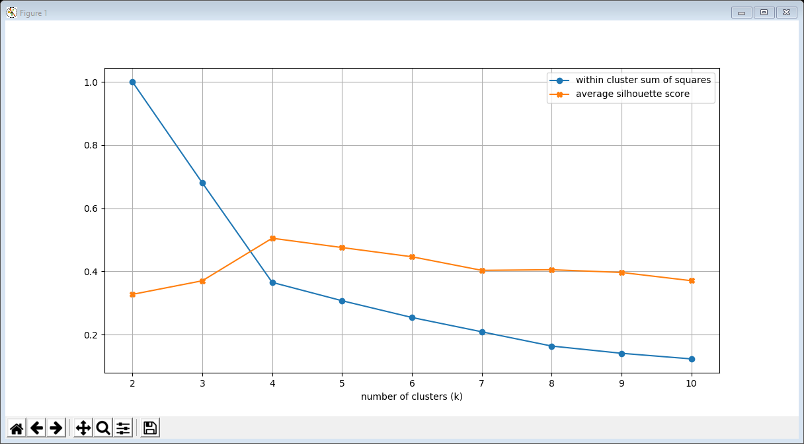
11LinePlot ratings clusterings.py
We can easily calculate the optimal number of clusters
The code is pretty much identical to examples 2 & 8
just use ratings as the data-frame and ratings.columns as selected (i.e. all columns are selected)
Both the elbow and the max silhouette score occur at k = 4

Slide 24
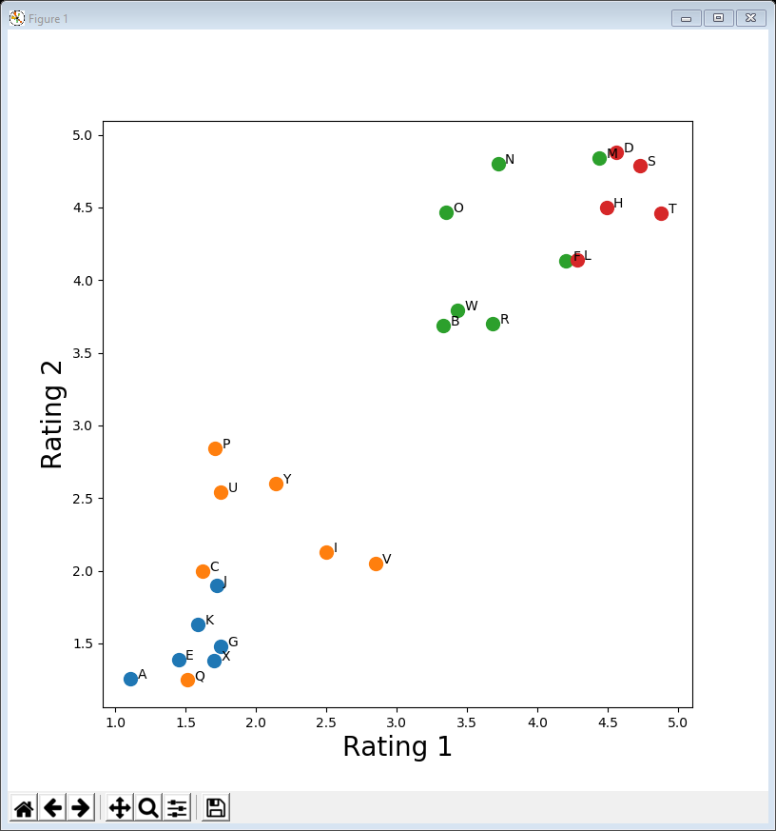
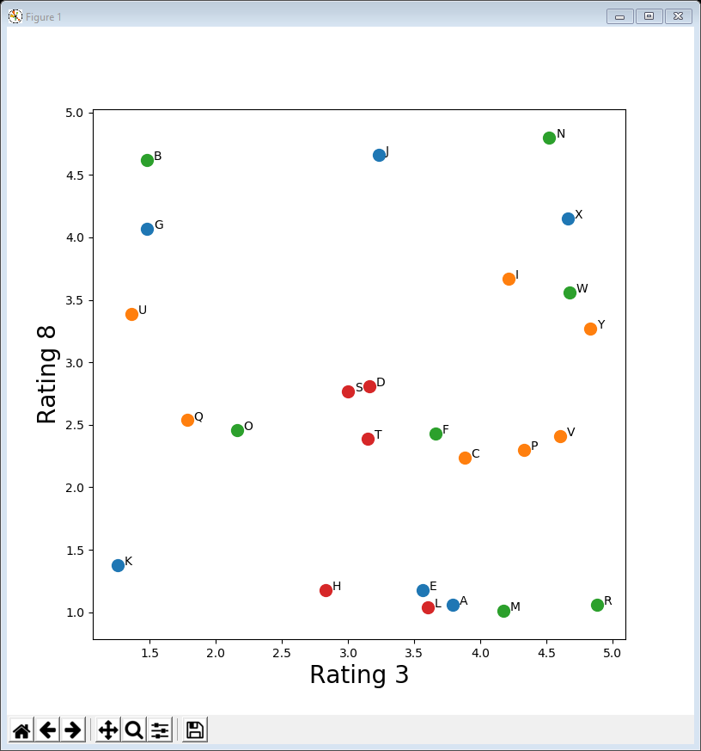
12ScatterPlot ratings clustering.py
The problem now is how do we visualise and therefore interpret our clustering with k = 4?
there are 10 dimensions so can’t use 3d plots
Can plot pairs of variables … may get lucky
We need some dimensionality reduction (next lecture)
… but Rating 3 vs Rating 8 is not ...
Rating 1 vs Rating 2 is quite helpful …
… and there are ½ x 10 x 9 = 45 pairs of ratings to look at in all

Slide 25
Lecture summary
Looked at k-means clustering plus techniques for choosing k
elbow method
silhouette maximisation
Made use of a number of visualisation techniques and saw a new one in action
3d scatter plot
In terms of data exploration
can successfully cluster variables with ease
more importantly, can interpret those clusters … provided the dimensions are low (e.g. 3)
Next week we will look at a method for dimension reduction

